Slide 1
Panel discussion: Conservation and sustainable use
Friedrich zur Heide GIZ BioInnovation Africa 14 September 2023

Slide 2
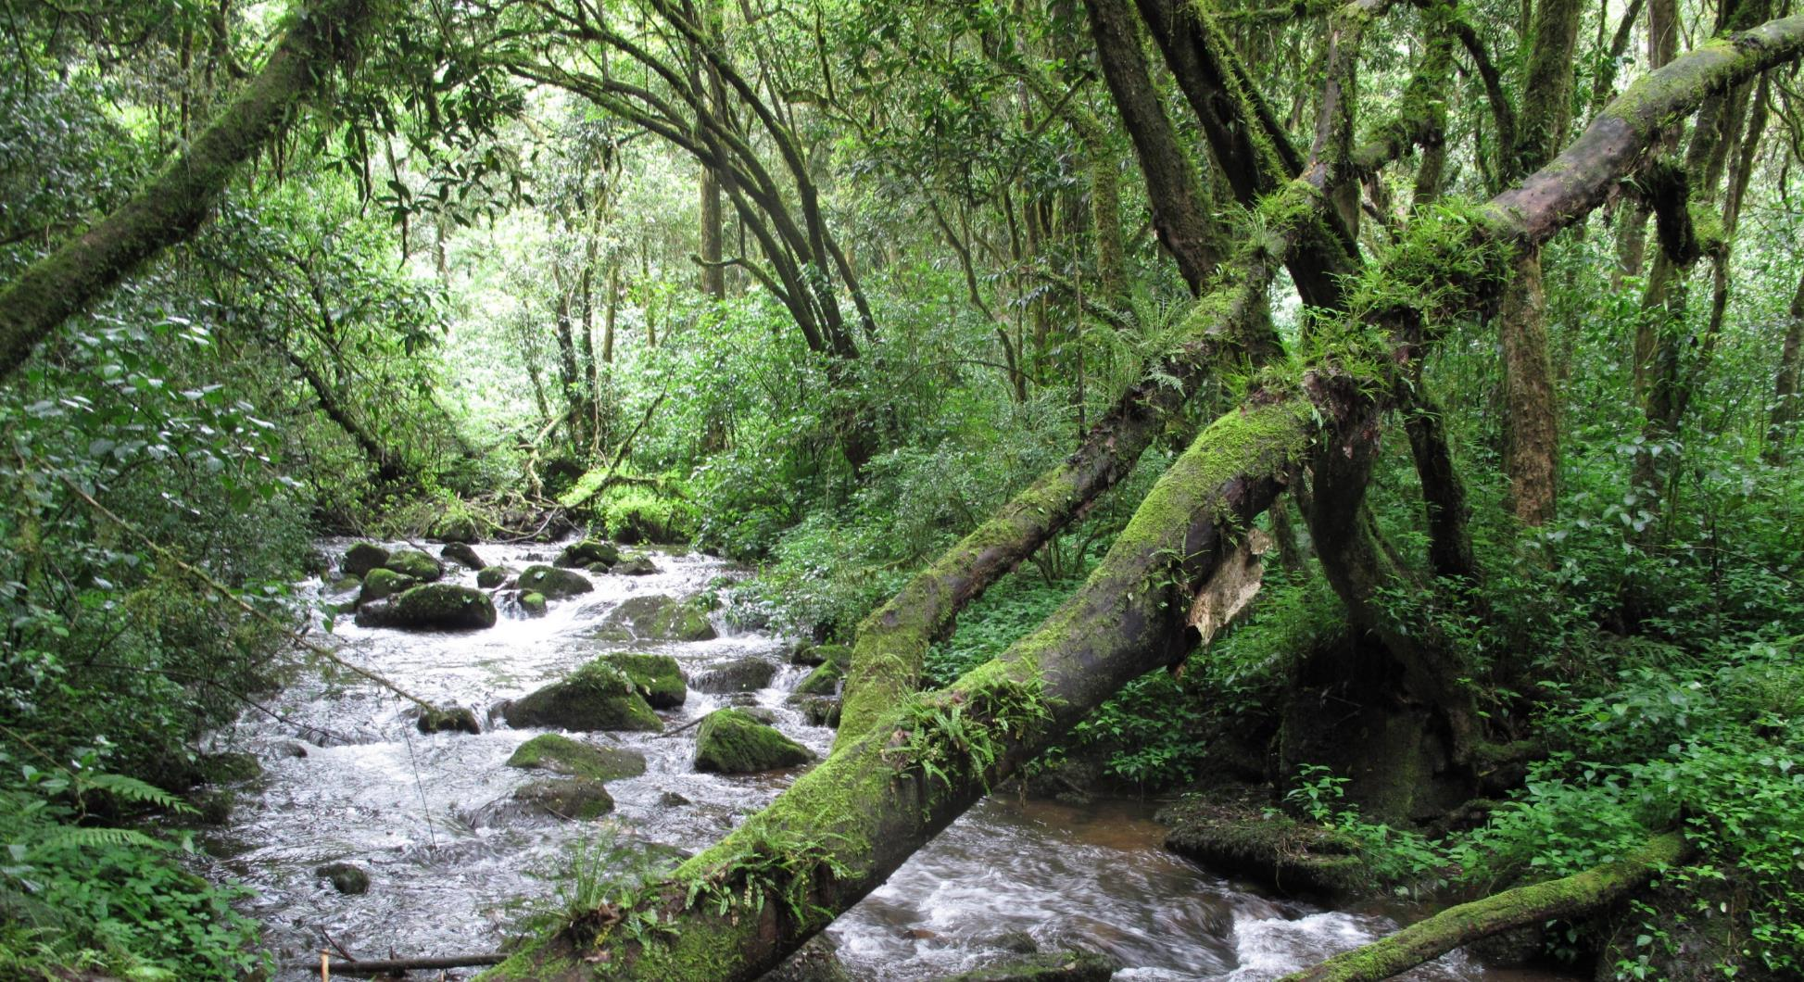
Key Aspects of the BS4CSU Guidelines
Integrating the Conservation and Sustainable Use of Biodiversity in ABS Approaches in South Africa
Presentation to the African Biotrade Fair 14 September 2023
Neil Crouch

Slide 3
https://bio-economy.org.za/wp-content/uploads/2023/04/BS4CSU-Guideline-Document.Web_.pdf
Prepared for the DFFE by the DSI/NRF
Bio-economy Chair at UCT,
Prof. Rachel Wynberg and Team

Slide 4
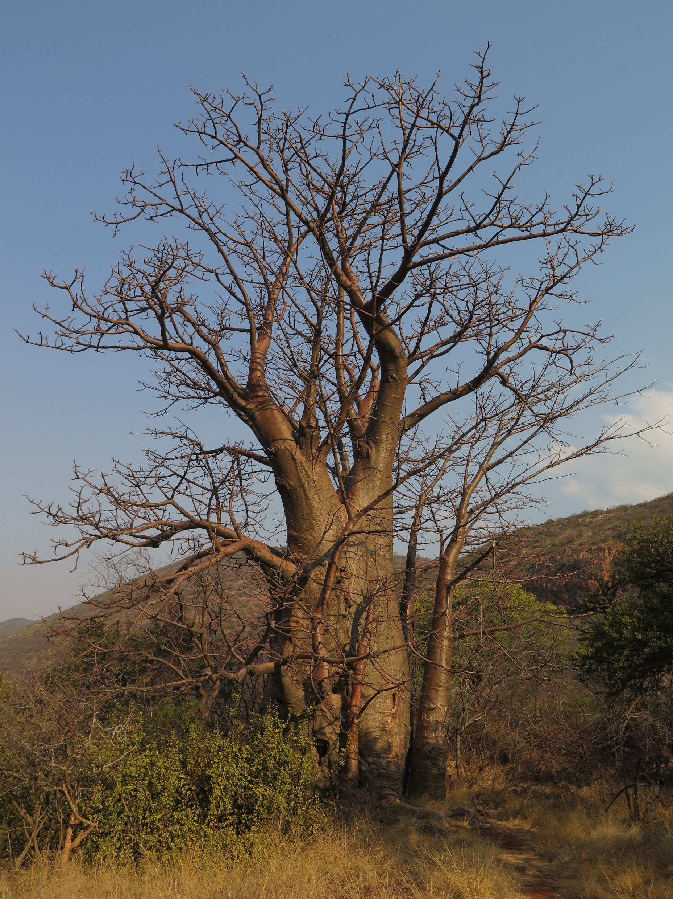
Aims of the Guidelines
To strengthen benefit sharing for the conservation and sustainable use of biodiversity in ABS agreements and other measures
To support actors involved in the biodiversity economy to strengthen biodiversity conservation and sustainable use
To enhance understanding of the potential of ABS-related activities to promote biodiversity conservation and sustainable use while addressing national, provincial and local environmental, social and economic priorities
Credit: Jonathon Rees
Credit: Jonathon Rees

Slide 5
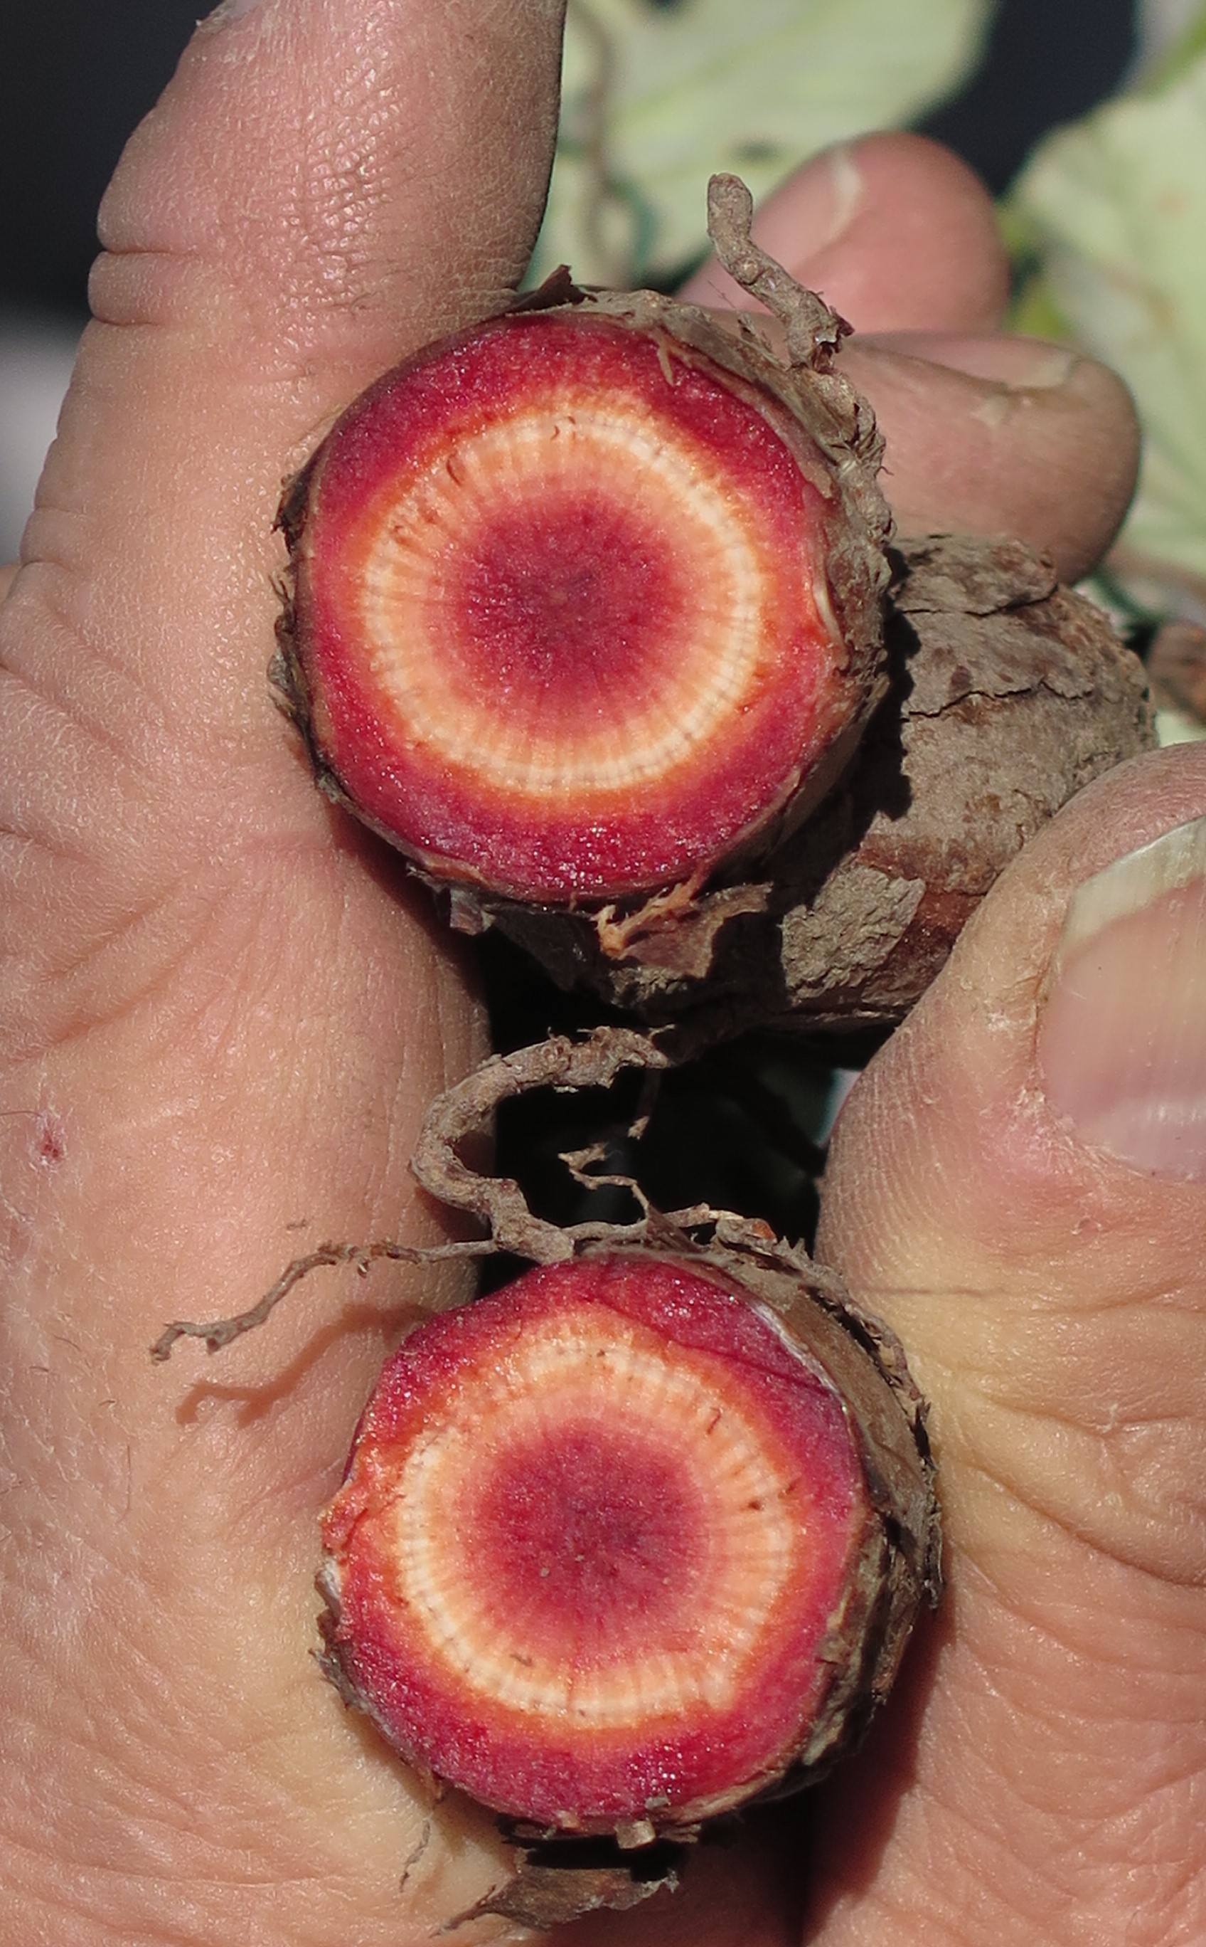
SOUTH AFRICAN CONTEXT
SA at forefront of ABS regulation and also has strong conservation history.
Conservation and ABS linked in NEMBA and specified as possible benefit in BABS but has had limited impacts on conservation. Most benefit-sharing agreements in SA do not incorporate benefits for the conservation and sustainable use of biodiversity
A focus on equity and regulatory compliance often turns attention away from conservation and sustainable use
National and provincial conservation priorities have not featured strongly

Slide 6
Aimed at regulators, users and providers
Voluntary, practical, and accessible
Principle-based: participation, transparency, transformation
Holistic approach to CSU: landscape and ecosystem levels

Slide 7
Includes microorganisms, cultivated and wild harvested species, marine and terrestrial ecosystems
Case studies draw on a variety of biomes and species
Implementation of CSU: straightforward, easy, and effective
CSU is viewed as a shared responsibility

Slide 8
SMART Benefits
(monetary or non-monetary)
S Specific
M Measurable
A Achievable
R Realistic
T Time-bound

Slide 9
PART A
PART B
Introduction
Laws, policies, strategies
Mechanisms
National CSU initiatives
Guidelines
Glossary of terms
Implementation
Appendices

